Slide 1
Effect of male circumcision on risk of HIV acquisition
Tianran Zhang

Slide 2
Introduction
Male circumcision in the prevention of heterosexual female-to-male HIV transmission has received considerable attention throughout sub-Saharan Africa.
Public health stake holders are considering future policy recommendations regarding circumcision alone or in combination with other prevention measures in reducing the HIV burden in sub-Saharan Africa.
Generalizability of RCT results and experiences to populations with unique cultural and epidemiologic characteristics must be fully considered in the planning of any widespread prevention initiative.

Slide 3
Causal question
To examine the protective effect of male circumcision in reducing heterosexual transmission of HIV from women to men.
This question is investigated based on the RCT data of Kericho HIV Cohort Study.

Slide 4
the Kericho HIV Cohort Study.
This is a 3.5-year observational, prospective cohort study aimed at estimating HIV prevalence, incidence, comorbidities, molecular epidemiology, and vaccine feasibility and acceptability among adult tea plantation workers and dependents in rural Kericho, Kenya.
The target population is 1378 male adult plantation workers and dependent volunteers aged 18 to 55 years, who was HIV-negative, with completed data at the end of the study.

Slide 5
Structural Causal Model (SCM)
Endogenous variables:
religion (W1)
tribe (W2)
sex with a commercial sex worker (W3)
diagnosis with a sexually transmitted infection (W4).
Circumcision status (A)
HIV status at two years of follow-up (Y).
Additional covariates:
income
educational status

Slide 6

Structural Causal Model (SCM)
Exogenous/background variables U:
Parents‘ religions, genetic predisposition to HIV, childhood environment, some emotional diseases, etc. might be included in the U.
We did not observe U, but we could do so​.

Slide 7
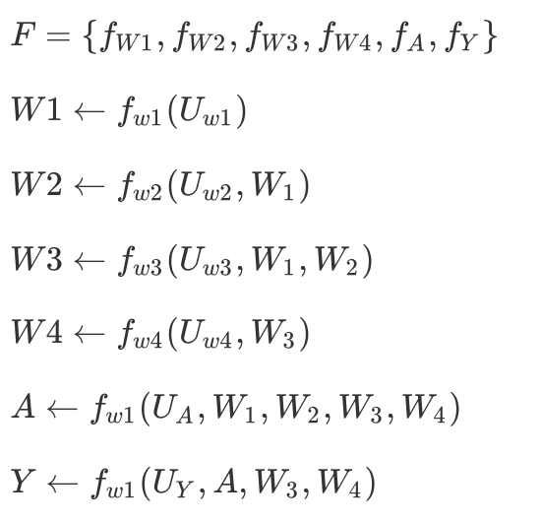
Structural Causal Model (SCM)
Structural equations F

Slide 8

Structural Causal Model (SCM)
Exclusion restrictions
religion and tribe do not directly affect one's diagnosis with a sexually transmitted infection or HIV status
Independence assumptions
The background information of religion and tribe share no unmeasured common causes with sexually transmitted infection.
We avoid making any unsupported assumptions on the joint distribution of the errors P ∗

Slide 9
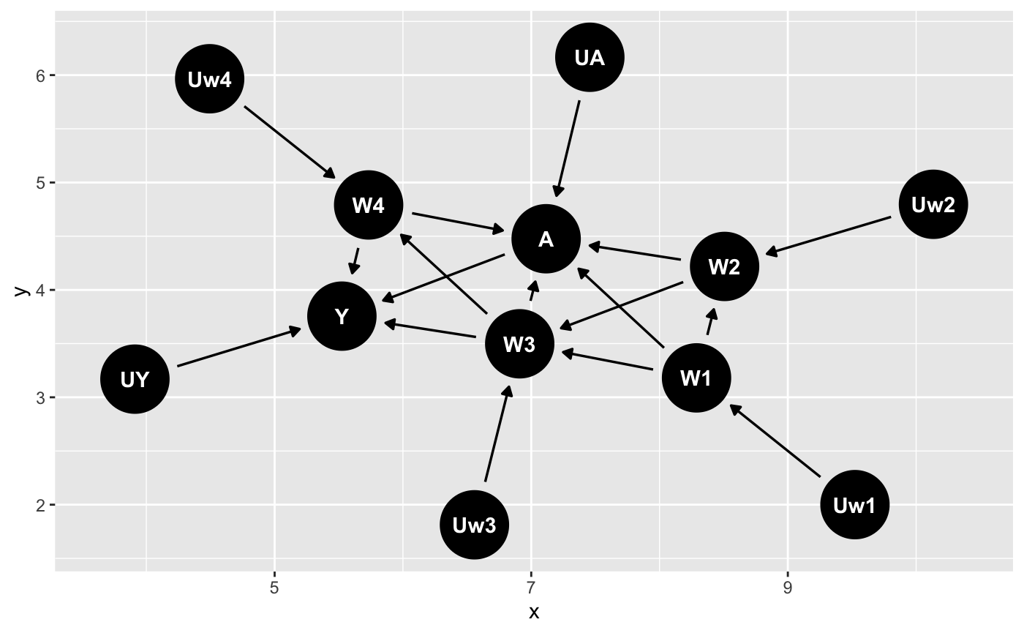
Structural Causal Model (SCM)
One possible causal graph

Slide 10
Counterfactual Outcome
Intervention node: A
Intervention of interest: taking circumcision for males.
Counterfactual Outcome:
Y1: counterfactual HIV status for a male if possibly contrary-to-fact he took circumcision A = 1.
Y0: counterfactual HIV status for a male if possibly contrary-to-fact he did not take circumcision A = 0.

Slide 11

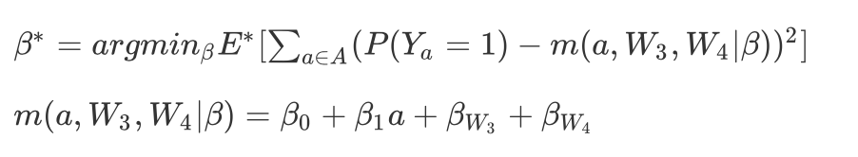
Target causal parameter
With marginal structural model
Causal risk difference: the difference in probabilities of diagnosing HIV between everyone took circumcision and that everyone did not take circumcision.
Without MCM:
I assumed the expected counterfactual outcome was a linear function of A, W3, and W4.

Slide 12
Q & A

